Slide 1
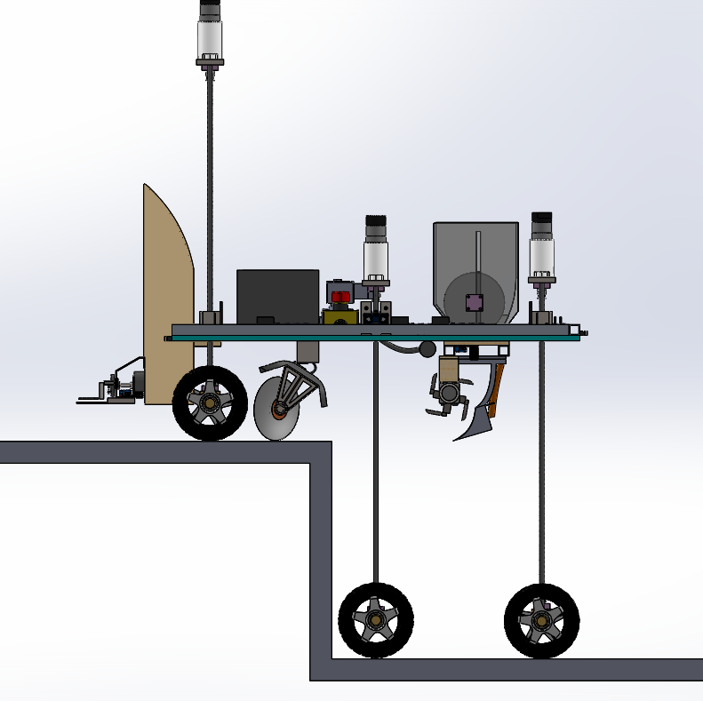
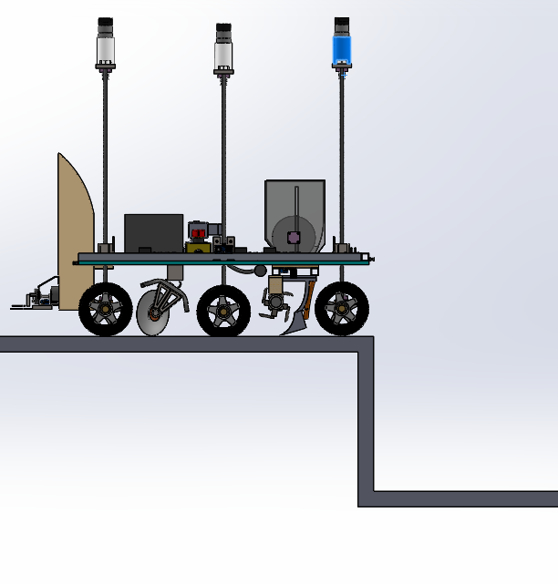
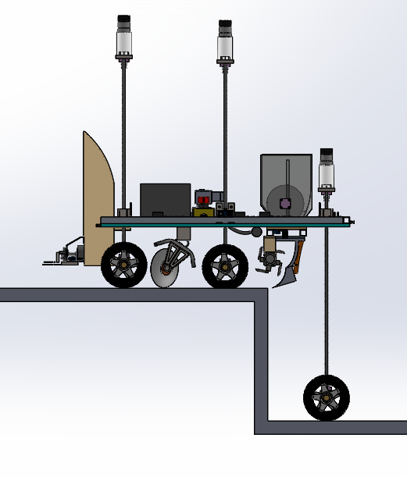
In the second step, the Middle Wheels will be pulled back up and the bot will move forward to rest on the stair on front and middle wheels.
In the first step, the lead screws of Middle and Back-wheel assemblies will be actuated and the chassis will be lifted up to 45cm above the ground. Then the bot will move forward until the front wheels rest above the stair.
In the last step, the back wheels will be pulled up and the bot will have climbed up the stair.

